Slide 1


Artificial Intelligence · CS3081
Multi-Factor Intelligent
Major Recommendation
System
Making major selection smarter, personalized, and data-driven.
Notes:
1

Slide 2


Exploring Your Path
02 / 07
Problem Statement & Domain
DOMAIN
Recommendation & Decision Support
Problem:
Students are choosing their futures with the
wrong information.
Gap:
Lack of integration of logical, emotional, and psychological factors
Solution:
AI-based system for personalized, multi-factor recommendations
Notes:
2

Slide 3






03 • PROJECT OBJECTIVES
What We Set Out to Achieve
01
02
Intelligent Agent
Multi-Factor Integration
Develop an AI agent for
university major selection
Combine logical, emotional, and
psychological dimensions
03
04
05
Ranked Recommendations
Input Robustness
Feedback Mechanism
Generate top-three majors with
explainable reasoning
Detect and handle conflicting or
inconsistent user inputs
Capture and store final student
decisions for refinement
Notes:
3

Slide 4
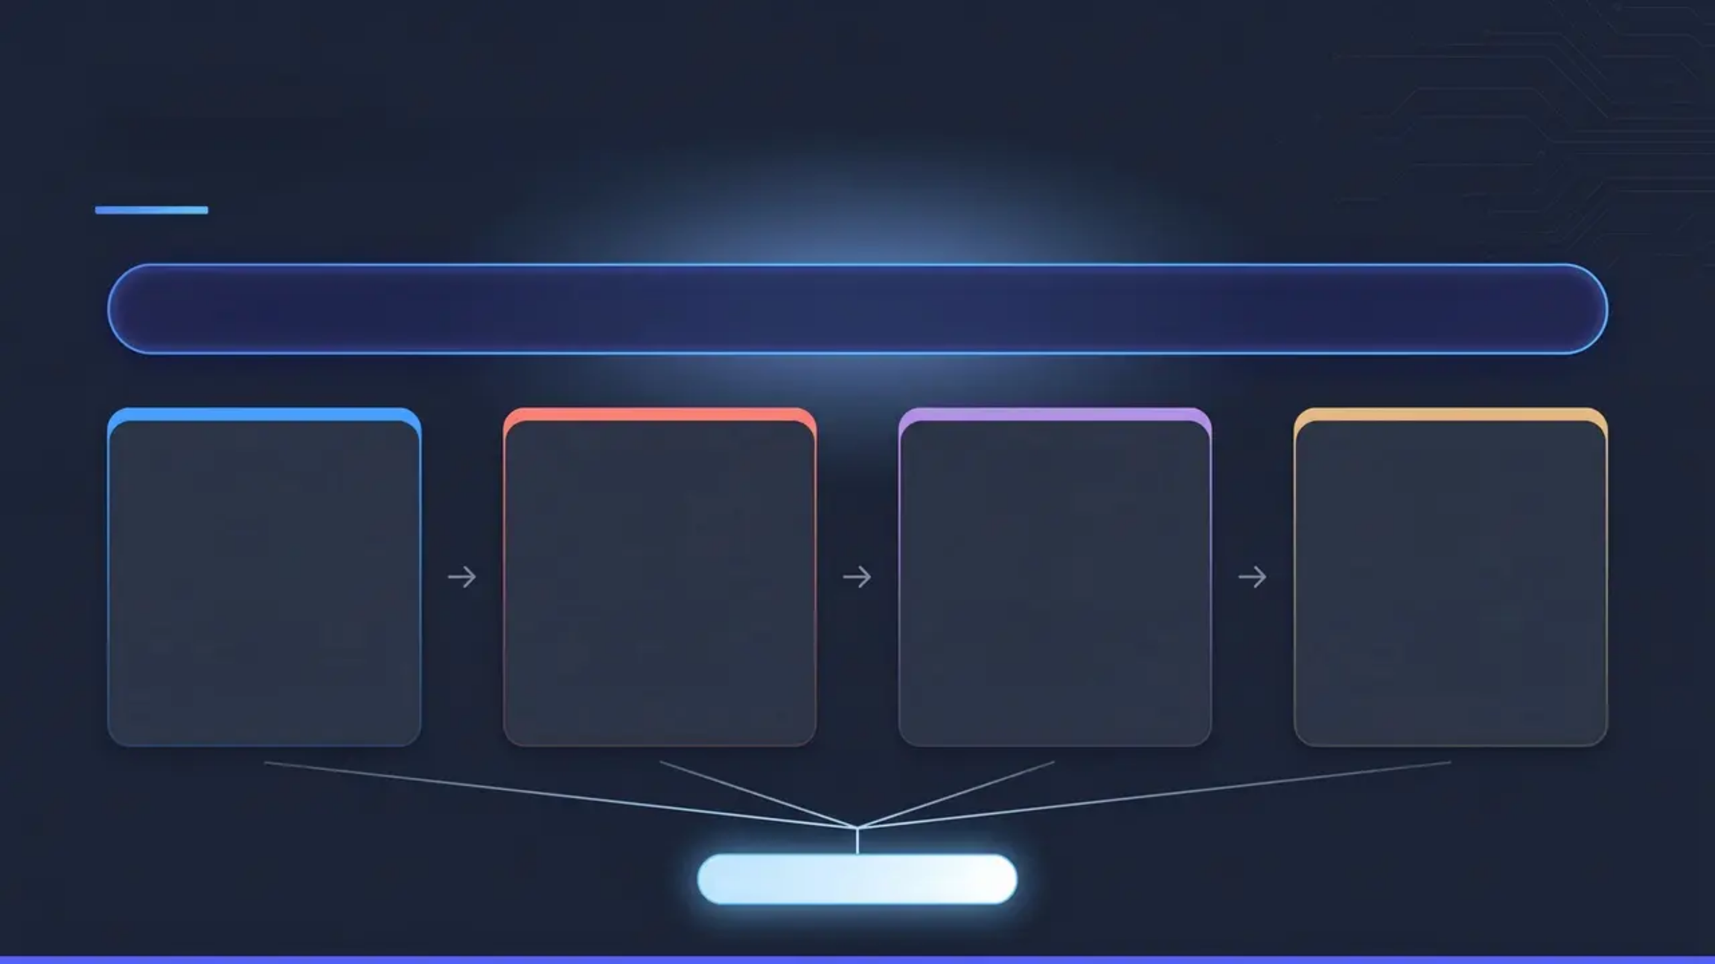




04 · Methodology
Weighted Scoring Model
Final Score = 0.40 × Logical + 0.30 × Emotional + 0.20 × Psychological + 0.10 × Market
40%
30%
20%
10%
Logical
Emotional
Psychological
Market
Academic performance
& skills assessment
Passion & personal
interests alignment
Personality traits &
cognitive style
Job market trends &
demand outlook
COMPATIBILITY SCORE
Notes:
4

Slide 5








05 • Implementation
Technical Stack & Features
Python
Streamlit
Core Language
Web Framework
Live System • Validation Screen
Input Validation & Robustness
Interactive Student Profile Input
No input inconsistencies detected. The profile is ready for recommendation.
Collects academic, interest, and personality data through a guided form interface.
Why validation matters
This module helps the system handle noisy, inconsistent, or extreme inputs. It improves robustness and supports the
adversarial handling part of the project.
Real-Time Scoring & Ranking
Save Student Profile
Reset Recommendation Results
Calculates compatibility scores instantly and ranks the top three majors.
Explanation Module
Provides transparent reasoning for the top recommendation to build user trust.
Validation Module
Detects conflicting or noisy inputs — the adversarial robustness layer.
Notes:
5

Slide 6


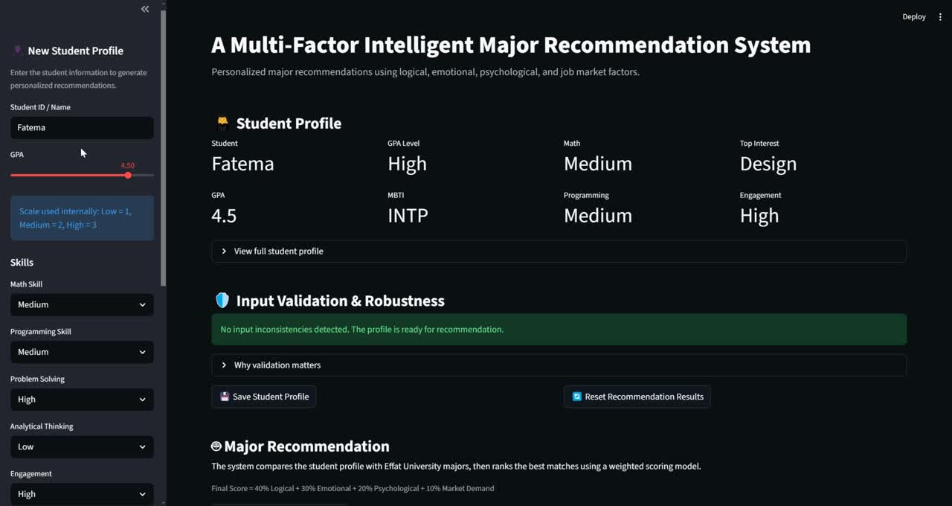


06 / 07
RESULTS & DISCUSSION
What the System Delivers
LIVE SYSTEM OUTPUT
Top Recommendations
Top 3 Majors Displayed
RANKED OUTPUT
Each major was scored and ranked in real time using the
student's full profile
Explainability
Reasoning You Can Trust
EXPLAINABILITY
The #1 recommendation includes a plain-language
justification covering academic fit, personality match, and
market demand.
Validation & Robustness
Handles Conflicting Inputs
ROBUSTNESS
Validation module flags contradictions — e.g., strong math
skills paired with a dislike for logic — before scoring begins
Notes:
6

Slide 7







Final Slide • 07
Conclusion & Future Work
CONCLUSION
FUTURE WORK
The Multi-Factor Intelligent Major
Recommendation System successfully
demonstrates how AI can enhance
transparency and personalization in
academic planning.
ML Integration
Incorporate predictive machine learning models for
greater accuracy
Expanded Majors Database
Cover a broader range of disciplines and career pathways
✔ Multi-dimensional scoring
Cloud Deployment
✔ Explainable AI outputs
✔ Robust input validation
Full deployment for scalable, institution-wide access
"Empowering students to make informed, confident decisions about their academic future."
Notes:
7

Slide 8



Final Slide • 08
Thank You for
Your Attention!
Questions & Discussion
Arwa Alshaikh • Farah Alnaqib • Maysoon Idris
Instructor: Dr. Naila Marir
Notes:
8

